Slide 1


Slide 2

Introduction To Data Analyst And Data Science For Beginners Lecture # 1 Introduction to Jupyter-Notebook and Python Programming
Ehtisham Sadiq

Slide 3
Today’s Agenda
Recap of Previous Lecture
Roles and Responsibilities of Data Analyst
Skills required to be a Data Analyst
Introduction to Python
History
Key Features of Python
Important Libraries & Frame Works
Applications
Organizations using Python
What is Jupyter Notebook
Dashboard and User interface of Jupyter Notebook
Variables In Python

Slide 4
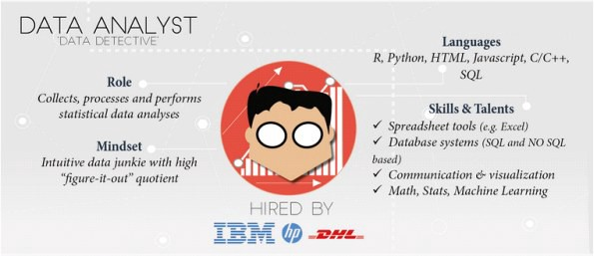
Data Analyst
Data analysis is a process of inspecting, cleansing, transforming and modeling data to discover useful information, informing conclusions and supporting decision-making. Data analysts collect, process and perform statistical analysis on the given data.

Slide 5

Data Analyst (Cont.)
Responsibilities of Data Analyst
Cleaning and organizing Raw data.
Analyzing data to derive insights.
Creating data visualizations.
Producing and maintaining reports.
Collaborating with teams/colleagues based on the insight gained.
Optimizing data collection procedures.

Slide 6
Data Analyst (Cont.)
Skills Required to be a data analyst
Statistical Programming
Programming Languages (R/SAS/Python)
Creative and Analytical Thinking
Business Acumen — Medium to High preferred
Strong Communication Skills.
Data Mining, Cleaning, and Munging
Data Visualization
Data Warehousing
Data Story Telling
SQL Databases (Database Querying Languages)
Advanced Microsoft Excel.

Slide 7
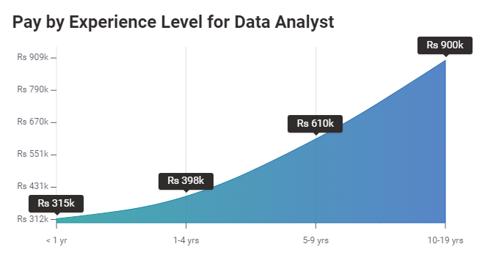
Data Analyst (Cont.)
Average Annual Salary of Data Analysts

Slide 8

Introduction to Python
History
Python is an interpreted, general-purpose, high-level programming language developed by Guido van Rossum
Version 1.0 was released in 1994, with features like exception handling, lambda, map, filter, and reduce. •
Version 2.0 was released in 2000 with features including, list comprehensions and garbage collection.
Version 3.0 was released in 2008.
Version 3.9.6 is latest stable version released in 2021

Slide 9
Introduction to Python(Cont.)
Key Features of Python
Python is a simple language due to its resemblance with English language, which increases its readability, writability, and makes it easy to learn. It cuts down the code about 20 percent of its actual size. 200-300 loc in Java = 50-60 loc in Python.
It is free and open source, which means one can freely distribute its copies, reads its source code, and modify it to experience different flavors of python.
Python is a high-level language, which makes programmers need not to bother about low-level details such as memory allocation etc., while practicing scripting in Python.
Python supports multiple programming paradigm as it provides procedural programming as well as object-oriented programming support.
It is a portable language as supported by many platforms like Linux, MS Windows, Mac, Free BSD, Solaris, BeOS and many more.
Python has extensive support for different libraries, that aims to provide assistance for performing complex tasks without starting from scratch.

Slide 10
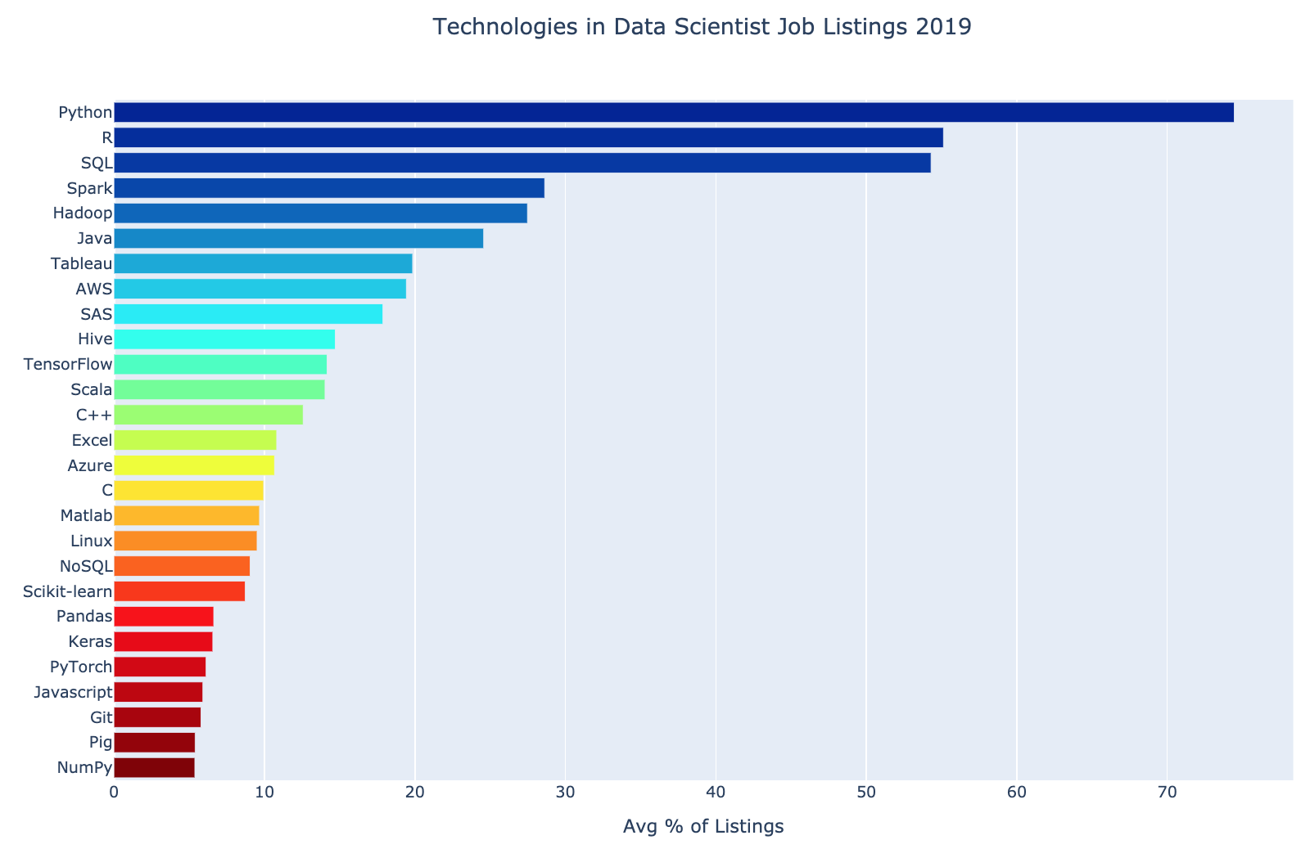
Introduction to Python(Cont.)
Importance of Python

Slide 11
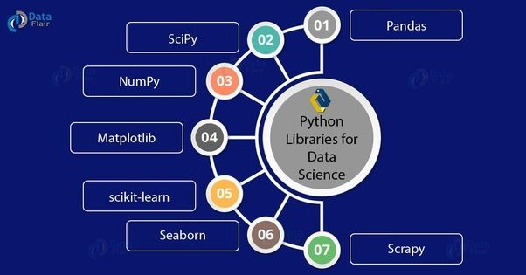
Introduction to Python(Cont.)
Important Libraries and Frame Works

Slide 12

Introduction to Python(Cont.)
Pandas
Data Analysis Data Cleaning
High level Abstraction
Data structure and Manipulation tools
NumPy
Numerical Computation
Faster computation with vectorization
N-Dimensional array creation
Matplotlib
Data Visualization (Bar Graph, Histogram , Scatter plot, Area Plot, Pie Plot)
Outliers Detection
Scikit-Learn
Machine Learning
Support supervised, unsupervised task
Regression, Clustering, Classification

Slide 13
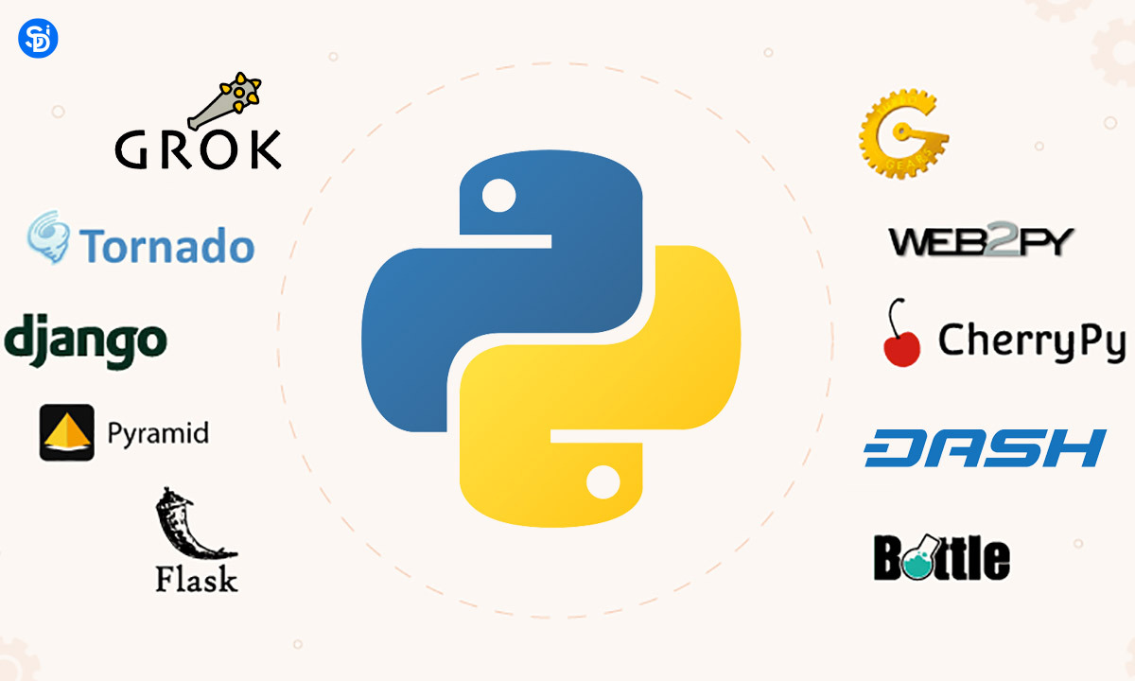
Introduction to Python(Cont.)
Frame Works of Python

Slide 14
Introduction to Python(Cont.)
Applications of Python
Web Development
Make web-applications at a rapid rate, because of frameworks it uses (Django, flask, pyramid).
Games Development
Used in developing interactive games, Uses PySoy and PyGame libraries.
Data Analysis
Libraires such as NumPy and Pandas help in data analysis and data extraction.
Machine Learning and AI
Libraires such as Pandas, Scikit-learn, NumPy helps in Machine learning and AI related tasks.
Web Scraping
Pull large amount of data from websites to use in real-world processes.

Slide 15
Introduction to Python(Cont.)
Organizations using Python
YouTube video sharing service is largely written in Python.
NASA uses Python for scientific programming tasks.
Google uses Python in web search system.
Dropbox storage service code is in Python
Netflix also uses Python.
NSA uses Python for cryptography and intelligence analysis .

Slide 16
Introduction to Jupyter Notebook
What is Jupyter Notebook
Jupyter Notebook is an open-source, web-based interactive environment, which allows you to create and share documents that contain live code, mathematical equations, graphics, maps, plots, visualizations, and narrative text. It integrates with many programming languages like Python, PHP, R, C#, etc. Jupyter Notebook mainly used for Python because Python is used with Artificial Intelligence (AI), Machine learning, as well as Deep learning.
Notebook is a single document where you can run code, display the output, and also add explanations, formulas, charts, and make your work more transparent, understandable, repeatable, and shareable.

Slide 17
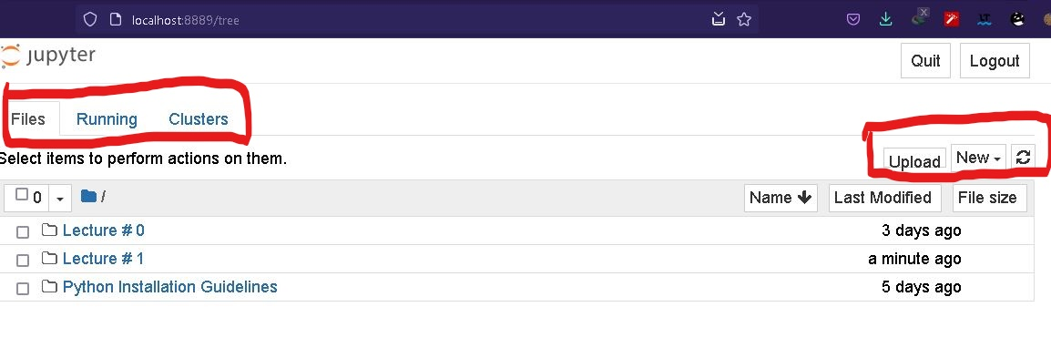
Introduction to Jupyter Notebook
Dashboard of Jupyter Notebook
Five Tabs
Files, Running , Clusters , Upload , New

Slide 18
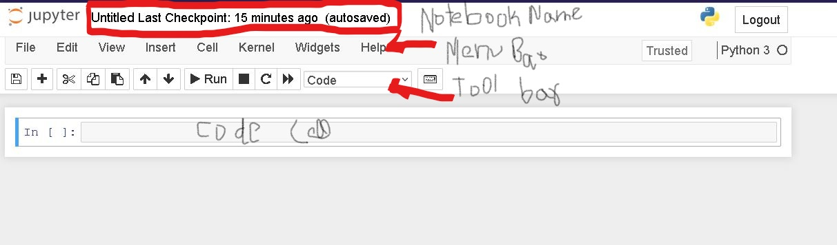
Introduction to Jupyter Notebook
User Interface of Jupyter Notebook
Types of Cells

Slide 19
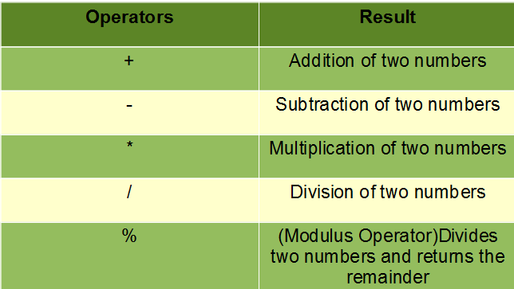
Operators in Python
Python supports the following arithmetic operators:

Slide 20
Variables In Python
A variable in Python is a reference rather a container.
Python is dynamically typed, which means you don’t have to associate a type with a variable name
we don’t have to explicitly declare a variable, rather the variable is created in the same statement, where we assign an object to the variable.
Number1 = 2
Number2 = 5
Number3 = Number1+Number2
print(Number3)

Slide 21
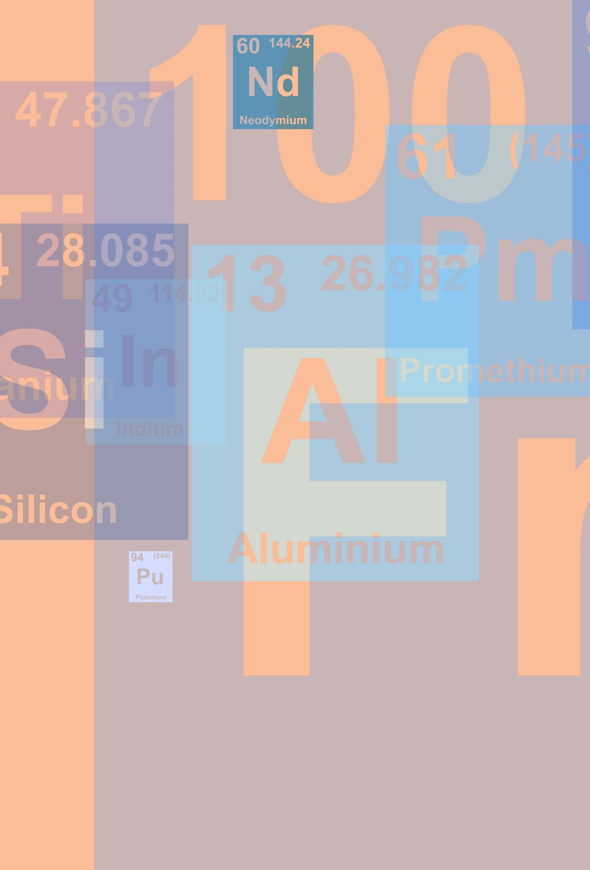
Variable Naming Rules
An identifier/variable name may only begin with A-Z, a-z, or an underscore(_).
This may be followed by letters, digits, and underscores- zero or more.
A number/digit can appear in the name, but not at the beginning.
Python is case-sensitive. Name and name are two different identifiers.
Spaces are not allowed. Instead, we must use snake case to make variable names readable.
The name of the variable should be something meaningful that describes the value it holds, instead of being random characters.

Slide 22

Three Properties Associated with every Variable
Identity: It can be considered as the address of the memory where the object is stored. An object’s identity never changes after it is created. In Python the id() function returns the type of an object.
Type: An object’s type defines the possible values and operations that the type support. For example, the integer type in Python support arithmetic operations, while string type support concatenation operation. An object’s type never changes after it is created. In Python the type() function returns the type of an object.
Value: It is the actual data stored in the object on which we perform various operations.

Slide 23

Variables Rules
Python Keywords: and, def, False, import, not, True, as, del, finally, in, or, try, assert, elif, for, is, pass, while, break, else, from, lambda, print, with, class, except, global, None, raise, yield, continue, exec, if, nonlocal, return
Demonstration

Slide 24

Any Question

